Slide 1
Filling and Wrapping Review
Review of prisms, circles and cylinders

Slide 2
Concepts reviewed:
Area → Space to cover 2D
Surface Area → Space to wrap 2D
Volume → Space to fill 3D

Slide 3
Find the area of this rectangle:

Slide 4
Find the area of this rectangle:
A) 38 cm² B) 26 cm²
C) 36 cm² D) None of these answers.

Slide 5
Find the area of this rectangle:
A) 38 cm² B) 26 cm²
C) 36 cm² D) None of these answers.

Slide 6
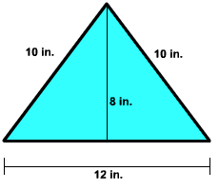
Find the area of this triangle:

Slide 7
Find the area of this triangle:
A) 120 in²
B) 60 in²
C) 48 in²
D) None of these answers.

Slide 8
Find the area of this triangle:
A) 120 in²
B) 60 in²
C) 48 in²
D) None of these answers.

Slide 9
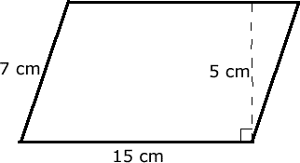
Find the area of this parallelogram:

Slide 10
Find the area of this parallelogram:
A) 105 cm²
B) 75 cm²
C) 37.5 cm²
D) None of these answers.

Slide 11
Find the area of this parallelogram:
A) 105 cm²
B) 75 cm²
C) 37.5 cm²
D) None of these answers.

Slide 12
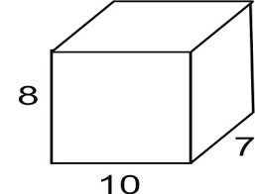
Find the volume of the rectangular prism:

Slide 13
Find the volume of the rectangular prism:
A) 1120 cm³
B) 280 cm³
C) 25 cm³
D) None of these answers.

Slide 14
Find the volume of the rectangular prism:
A) 1120 cm³
B) 280 cm³
C) 25 cm³
D) None of these answers.

Slide 15
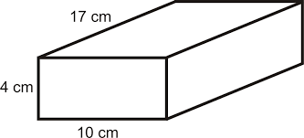
Find the surface area of the rectangular prism:

Slide 16
Find the surface area of the rectangular prism:
A) 680 cm²
B) 556 cm²
C) 278 cm²
D) None of these answers.

Slide 17
Find the surface area of the rectangular prism:
A) 680 cm²
B) 556 cm²
C) 278 cm²
D) None of these answers.

Slide 18
Find the surface area of the rectangular prism:

Slide 19
Find the surface area of the rectangular prism:
A) 180 ft²
B) 17 ft²
C) 144 ft²
D) None of these answers.

Slide 20
Find the surface area of the rectangular prism:
A) 180 ft²
B) 17 ft²
C) 144 ft²
D) None of these answers.

Slide 21
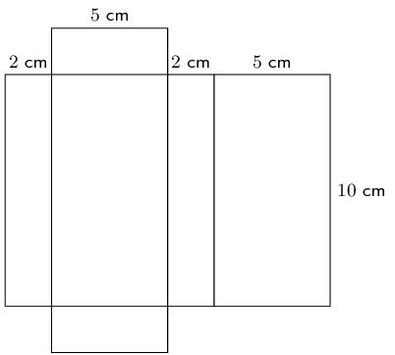
Find the surface area of the rectangular prism:

Slide 22
Find the surface area of the rectangular prism:
A) 140 cm²
B) 1000 cm²
C) 160 cm²
D) None of these answers.

Slide 23
Find the surface area of the rectangular prism:
A) 140 cm²
B) 1000 cm²
C) 160 cm²
D) None of these answers.

Slide 24
Find the volume of the rectangular prism:

Slide 25
Find the volume of the rectangular prism:
A) 100 cm³
B) 140 cm³
C) 1000 cm³
D) None of these answers.

Slide 26
Find the volume of the rectangular prism:
A) 100 cm³
B) 140 cm³
C) 1000 cm³
D) None of these answers.

Slide 27
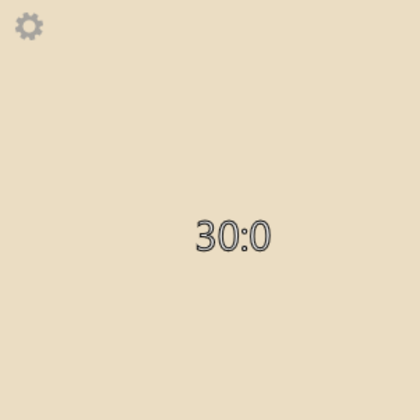
Each of these prisms has the same volume. Which has the least surface area?
A)
B)
C)
D)

Slide 28
Each of these prisms has the same volume. Which has the least surface area?
A)
B)
C)
D)

Slide 29
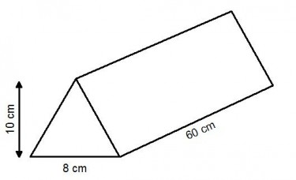
Find the volume of the prism:

Slide 30
Find the volume of the prism:
A) 4800 cm³
B) 1080 cm³
C) 2400 cm³
D) None of these answers.

Slide 31
Find the volume of the prism:
A) 4800 cm³
B) 1080 cm³
C) 2400 cm³
D) None of these answers.

Slide 32
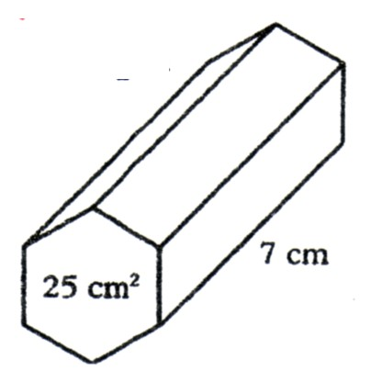
Find the volume of the prism:

Slide 33
Find the volume of the prism:
A) 32 cm³
B) 192 cm³
C) 1050 cm³
D) None of these answers.

Slide 34
Find the volume of the prism:
A) 32 cm³
B) 192 cm³
C) 1050 cm³
D) None of these answers.

Slide 35
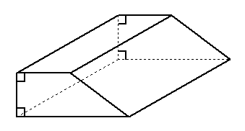
Find the volume of the prism:
h = 12 cm
A = 22 cm²

Slide 36
Find the volume of the prism:
A) 34 cm³
B) 264 cm³
C) 132 cm³
D) None of these answers.
h = 12 cm
A = 22 cm²

Slide 37
Find the volume of the prism:
A) 34 cm³
B) 264 cm³
C) 132 cm³
D) None of these answers.
h = 12 cm
A = 22 cm²

Slide 38
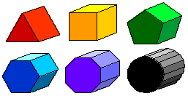
Each of these prisms was made from one sheet of paper. Which has the greatest volume?
A)
B)
C)
D)
AB)
CD)

Slide 39
Each of these prisms was made from one sheet of paper. Which has the greatest volume?
A)
B)
C)
D)
AB)
CD)

Slide 40
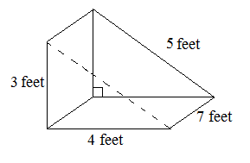
Find the surface area of the triangular prism:

Slide 41
Find the surface area of the triangular prism:
A) 84 ft²
B) 96 ft²
C) 108 ft²
D) None of these answers.

Slide 42
Find the surface area of the triangular prism:
A) 84 ft²
B) 96 ft²
C) 108 ft²
D) None of these answers.

Slide 43
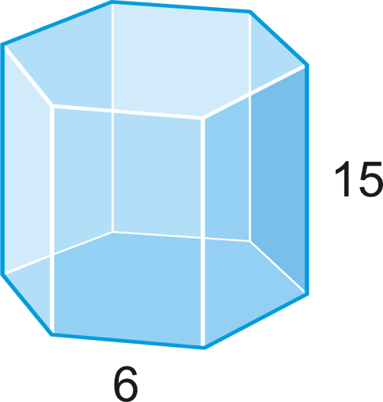
Find the surface area of the hexagonal prism:
A = 93.5 cm²

Slide 44
Find the surface area of the hexagonal prism:
A = 93.5 cm²
A) 183.5 cm²
B) 273.5 cm²
C) 727 cm²
D) None of these answers.

Slide 45
Find the surface area of the hexagonal prism:
A = 93.5 cm²
A) 183.5 cm²
B) 273.5 cm²
C) 727 cm²
D) None of these answers.

Slide 46
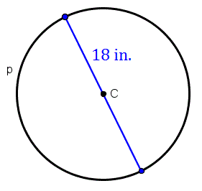
Find the circumference of this circle:

Slide 47
Find the circumference of this circle:
A) 324 in
B) 56.5 in
C) 28.3 in
D) None of these answers.

Slide 48
Find the circumference of this circle:
A) 324 in
B) 56.5 in
C) 28.3 in
D) None of these answers.

Slide 49
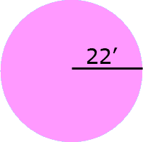
Find the circumference of this circle:

Slide 50
Find the circumference of this circle:
A) 69.1 ft
B) 1520.5 ft
C) 138.2 ft
D) None of these answers.

Slide 51
Find the circumference of this circle:
A) 69.1 ft
B) 1520.5 ft
C) 138.2 ft
D) None of these answers.

Slide 52
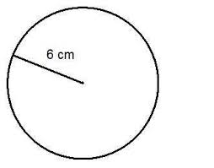
Find the area of this circle:

Slide 53
Find the area of this circle:
A) 36 cm²
B) 18.8 cm²
C) 226.2 cm²
D) None of these answers.

Slide 54
Find the area of this circle:
A) 36 cm²
B) 18.8 cm²
C) 226.2 cm²
D) None of these answers.

Slide 55
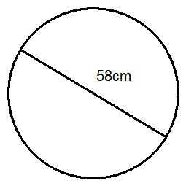
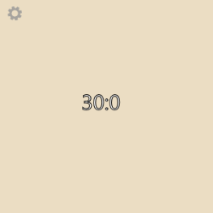
Find the area of this circle:

Slide 56
Find the area of this circle:
A) 2642.1 cm²
B) 182.2 cm²
C) 10,568.3 cm²
D) None of these answers.

Slide 57
Find the area of this circle:
A) 2642.1 cm²
B) 182.2 cm²
C) 10,568.3 cm²
D) None of these answers.

Slide 58
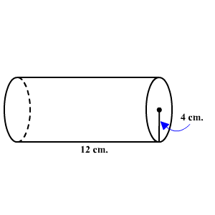
Find the volume of the cylinder:

Slide 59
Find the volume of the cylinder:
A) 48 cm³
B) 603.2 cm³
C) 150.8 cm³
D) None of these answers.

Slide 60
Find the volume of the cylinder:
A) 48 cm³
B) 603.2 cm³
C) 150.8 cm³
D) None of these answers.

Slide 61
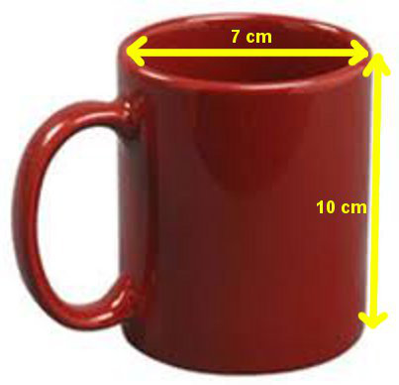
Find the volume of the cylinder:

Slide 62
Find the volume of the cylinder:
A) 384.8 cm³
B) 70 cm³
C) 1539.4 cm³
D) None of these answers.

Slide 63
Find the volume of the cylinder:
A) 384.8 cm³
B) 70 cm³
C) 1539.4 cm³
D) None of these answers.

Slide 64
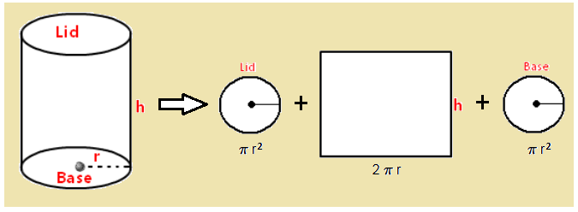
Find the surface area of the cylinder:
3
8
8
h

Slide 65
Find the surface area of the cylinder:
3
8
8
A) 104.5 cm² B) 56.5 cm²
C) 207.3 cm² D) None of these answers.

Slide 66
Find the surface area of the cylinder:
3
8
8
A) 104.5 cm² B) 56.5 cm²
C) 207.3 cm² D) None of these answers.

Slide 67
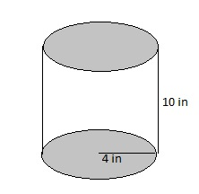
Find the surface area of the cylinder:

Slide 68
Find the surface area of the cylinder:
A) 301.6 cm²
B) 351.9 cm²
502.7 cm²
D) None of these answers.

Slide 69
Find the surface area of the cylinder:
A) 301.6 cm²
B) 351.9 cm²
502.7 cm²
D) None of these answers.

Slide 70
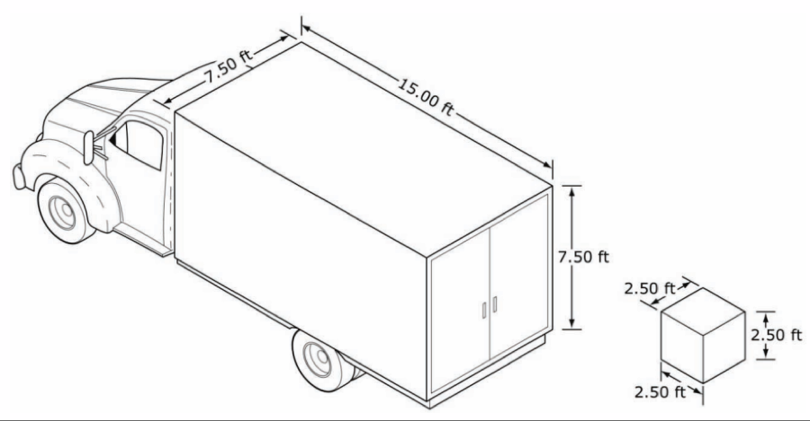
How many boxes will fit in the back of the truck?

Slide 71
How many boxes will fit in the back of the truck?
A) 45 boxes
B) 135 boxes
C) 54 boxes
D) None of these answers.

Slide 72
How many boxes will fit in the back of the truck?
A) 45 boxes
B) 135 boxes
C) 54 boxes
D) None of these answers.

Slide 73
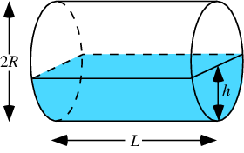
Find the volume of water in the tank:
Radius
= 3 ft
20 ft

Slide 74
Find the volume of water in the tank:
A) 565.5 ft³
B) 60 ft³
C) 282.7 ft³
D) None of these answers.
Radius
= 3 ft
20 ft

Slide 75
Find the volume of water in the tank:
A) 565.5 ft³
B) 60 ft³
C) 282.7 ft³
D) None of these answers.
Radius
= 3 ft
20 ft

Slide 76
All Done!
Concepts reviewed:
Area → Space to cover
Surface Area → Space to wrap
Volume → Space to fill

